Slide 1
Zeal.Co
Expansion Plan Presentation

Slide 2
Flow of the Presentation
Our Story
Organization Chart
Why Bangladesh?
Overcoming the Challenges
Entry Strategy
Integrated Marketing Communication
International Strategy
Addressing the Doubts
Launch Strategies (and sub parts)
Conclusion
Rationale for choosing the strategy
Notes:
We are here to present our expansion plan for Zeal which is our clothing brand. We named our brand Zeal because it was originated from our passion of having a brand of our own. Zeal is something which drives all of us and now we wish to expand it further and make it more successful. This is the flow of our presentation and we will be covering these areas to talk about why do we want to expand our brand. We have tried to answer as many questions as possible and have provided rationale of our strategies.

Slide 3
Our Story
The Dream Team
Notes:
Zeal, our clothing brand, started off as a passion for all four of us. We wanted to have something of our own. . .and we worked towards it
Target audience is young youth, who are outgoing, social, flexible and can step out of their comfort zone
Our USP is ‘no to carbon emission’ which also helps us attract environment conscious customers
Our tee-shirt designs clearly reflect our target audience, and hence the demand is surpassing the supply
Therefore, we wish to expand manufacturing operations in Bangladesh to increase production volume and price competitiveness

Slide 4
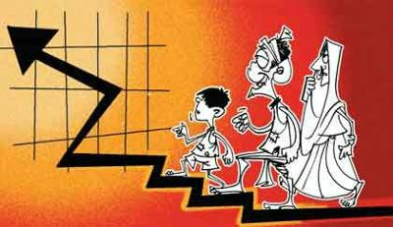
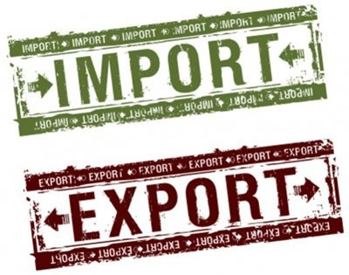
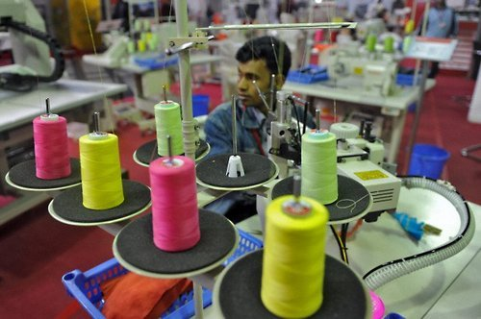
Why Bangladesh?
Bangladesh, A Success Story
Notes:
Investment Point-of-view
Bangladesh is considered a success story as 40 years since independence, the poverty rate has plummeted from 80 percent down to less than 30 percent today, GDP growth has averaged around 5-6 percent for over 20 years, and the clothing industry has had a lot to do with it
In 2013, Bangladesh exported nearly $31 billion of goods overall—nearly twice what it did just four years earlier in 2009—according to data from the International Trade Centre.
About 90% of that value, some $28 billion, came from clothes. It is the world’s second-largest garment exporter, and its share of the global closet just keeps growing

Slide 5
Notes:
Bangladesh rose to its position largely because of its lack of regulation and the low wages it pays its garment workers, most of whom are women. Bangladesh’s minimum wage for the sector is one of the world’s lowest —or according to some groups, the very lowest—even after the government raised it in response to fallout from the Rana Plaza disaster. As fashion brands look to cut costs, and wages continue to rise in China, Bangladesh becomes an increasingly attractive place to make clothes on the cheap.

Slide 6
Notes:
Marketing Point-of-view
Bangladesh’s very large number of young people is a dynamic and trendy generation
To keep pace with the current world they try to transfigure themselves and set their lifestyle to modernize their approach
Language is at the heart of their entertainment. Browsing many channels arouses a deep enticement towards foreign languages.
They are not bound to typical jobs anymore, which means they have become more expressive about who they are who they want to be
With Bangladesh being so exotic, its people and products get ignored sometimes. Domestic companies are suffering, not because they compromise quality but because the new generation loves foreign products more.
From time to time they update themselves. Their education, dreams, lifestyle, language and even hobbies- everything is a sign to acknowledge their high ambitions

Slide 7
Entry Strategy
Notes:
As Zeal is a fairly new company, our strategy to enter in Bangladesh market will be to partner with a textile firm who will provide us clothing material and also aid in production of our tee shirts. The reason we want to partner with a textile firm is because we cannot open a textile mill from scratch in a new country and we want to test out the market first and see their response towards our brand. We will pick up top performing textile mills and see their profitability and then choose one to co-brand with. As co-branding their logos will be displayed on our promotional material.

Slide 8
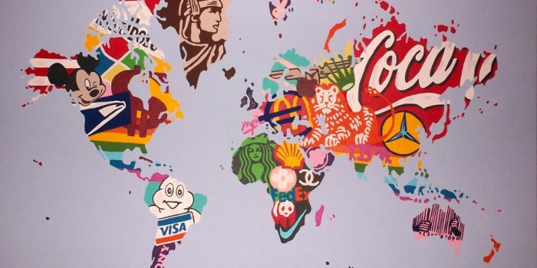
International Strategy
Notes:
The strategy which we will be going ahead with is Transnational Strategy. We will seek a middle ground between a multidomestic strategy and a global strategy. We will try to balance the desire for efficiency with the need to adjust to local preferences within Bangladesh. For example, we will implement the same model we have applied in Australia with our western flair, however, we will also localize our offerings to suite the needs of local consumers. Although the cost pressure is a bit more high in Transnational strategy, the Local Responsiveness is also higher which is what we are seeking. We will talk about further as we move ahead.

Slide 9
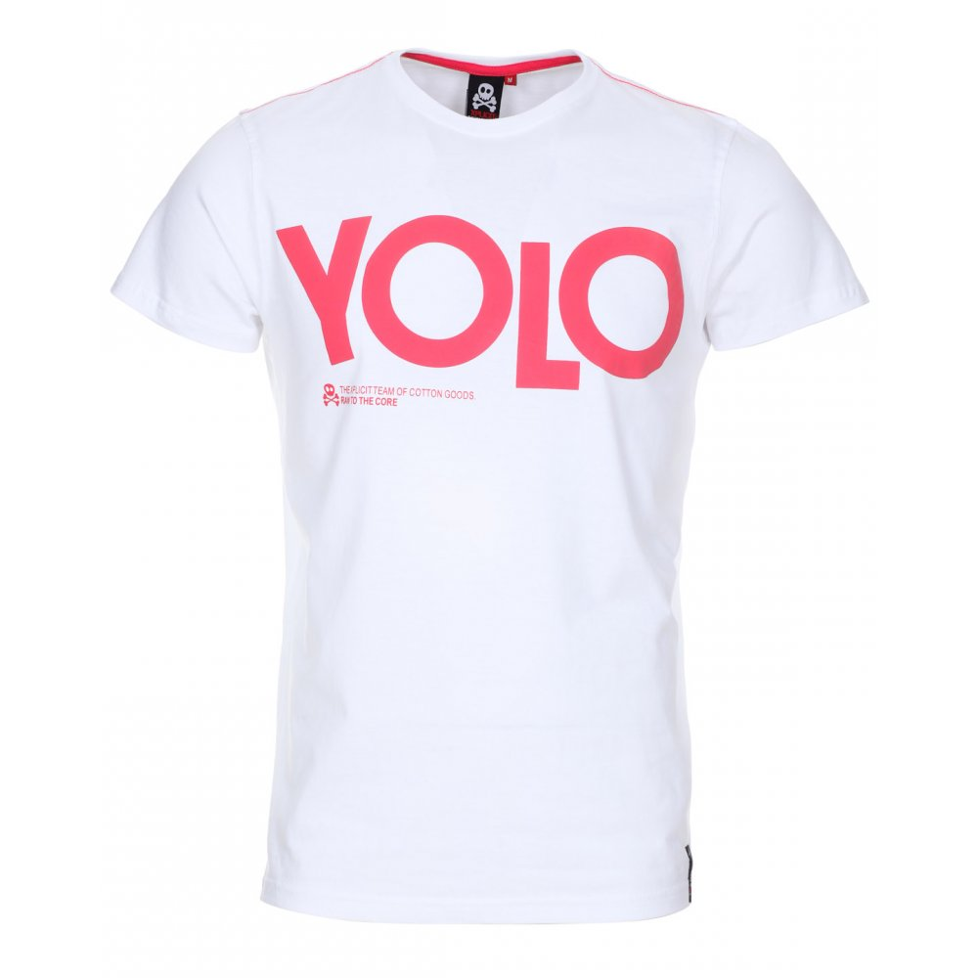
Launch Strategies
Notes:
Considering the facts we have mentioned above, it can be said that shifting manufacturing operation in Bangladesh will be profitable
Our launch Strategy would be to be replicate the same model we have utilized in Australia
Reason being, Bangladeshi audience love the foreign touch so we will target the youth through our best sellers i.e. ‘YOLO’ and ‘shake it off’
Once we have penetrated in the market, we will localize our offering, i.e. printing messages on our tee-shirts in local language that is Bengali to add a local flavor
This will be a limited edition range and will only be launched to reinforce the brand awareness
Moreover, Bangladeshi audience is a little price sensitive so we will price our shirts in mid-range brackets

Slide 10
Brand Awareness
Notes:
Bangladesh must be having a number of existing clothing brands and we don’t want to be just another apparel brand in the industry
Therefore, as a launch campaign we will run a social media campaign as most of our target audience is present on social media
We will market our launch on Australian social media pages as well so that Bangladeshi locals can be diverted from their as well
We believe that Zeal is for people who are new age and tech savvy hence we will not invest in traditional media

Slide 11
Online Selling
Notes:
At first we will only be operating through online selling of our products and building on the e-commerce industry of Bangladesh
We don’t want to open up a number of stores all at once, we will monitor the audience response and their liking pattern towards our design and then we will move on towards opening up outlets
We wish to utilize the current trend of flouring e-commerce where budgetary investments are low and marketing is done through social and digital platforms

Slide 12
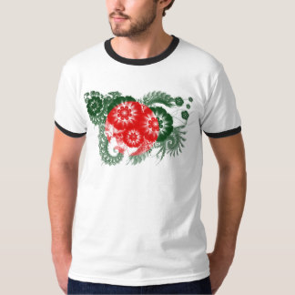
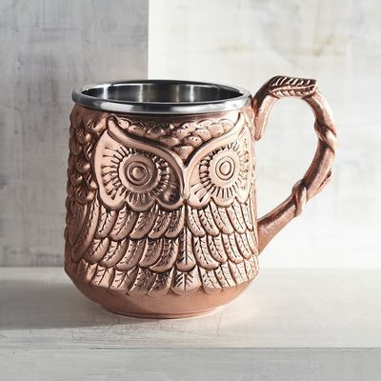
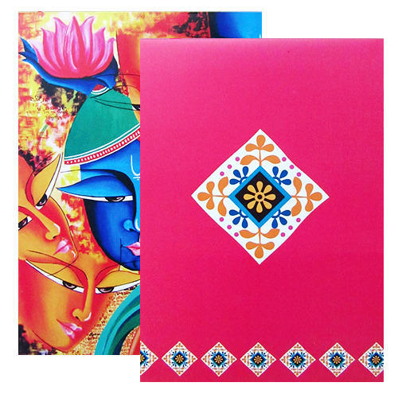
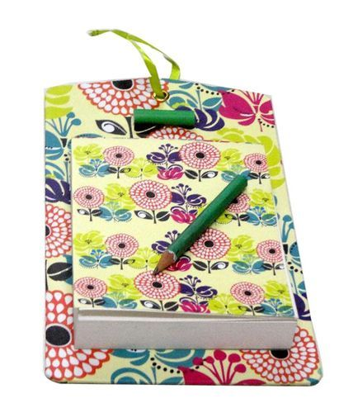
Adding the Local Touch
Notes:
As much as Bangladeshi youth likes the foreign trends, they would love if local touch is added and brought by an international firm to them
We will launch a limited edition tee-shirt range along with some other items such as mugs, key chains, notebooks, etc with local colors, and messages printed on them in the local language
This would help us communicate that we are one of them and they we are here for their benefit

Slide 13
Rationale for choosing the strategy
Bangladeshi youth’s interest towards foreign products
Not willing to go for something which is local
foreign touch to keep the essence of the brand intact
No carbon emission policy
Notes:
The reason we want to replicate the existing model is because we see Bangladeshi youth’s interest towards foreign products
They don’t want to go for something which is local, and as we will be producing and selling there locally, we need a foreign touch to keep the essence of the brand intact
Moreover, are no carbon emission policy will also appear to be something new, something none of the local brands in Bangladesh is doing and it will help us stand out

Slide 14
Organization Chart
Notes:
As marketing, sales and production are going to be are three main operation in Bangladesh, we will stick to revolve our organizational structure around that. At first we want to keep our number of employees less until we are well established. However, we will work towards building a lucrative team of talented individuals and will hire some locals as well so that they can give their inputs too. Their will be front end managers as well working under the managers we have mentioned above.

Slide 15
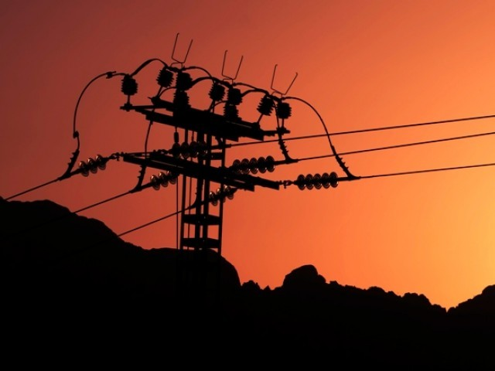
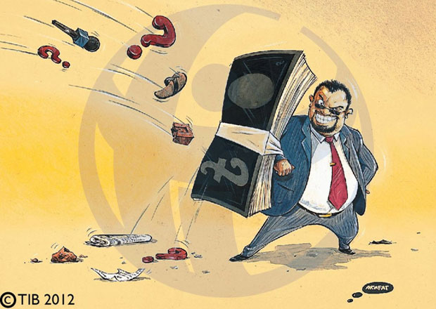
Challenges we are likely to face . . .
Notes:
Despite relatively strong economic growth over the past decade, investment climate constraints, notably deficiencies in energy and transportation infrastructure, and an opaque regulatory environment have prevented Bangladesh from achieving higher growth.
No concrete transportation infrastructure is a big challenge as our logistics network is mainly dependent on timely delivery of products to our customers.
Corruption is widely perceived to be endemic at all levels of society and discourages some investments and inhibits economic growth.
Political unrest stemming from the January 5, 2014 national elections was minimal in 2016 compared to past years. However, projections of continued GDP growth of approximately 6.8 percent show the resilience of Bangladesh’s economy in weathering these challenges.

Slide 16
Cont.
Reputable companies have complained that the National Board of Revenue, Bangladesh (NBR) is unduly reopening prior year tax returns for additional scrutiny.
Worker safety concerns and labor laws
Notes:
A series of RMG industry accidents, including the tragic death of more than 1,100 workers in the Rana Plaza Complex collapse in April 2013, have highlighted the ongoing need for improved worker safety and labor rights in Bangladesh and led to pioneering initiatives to improve factory safety.

Slide 17
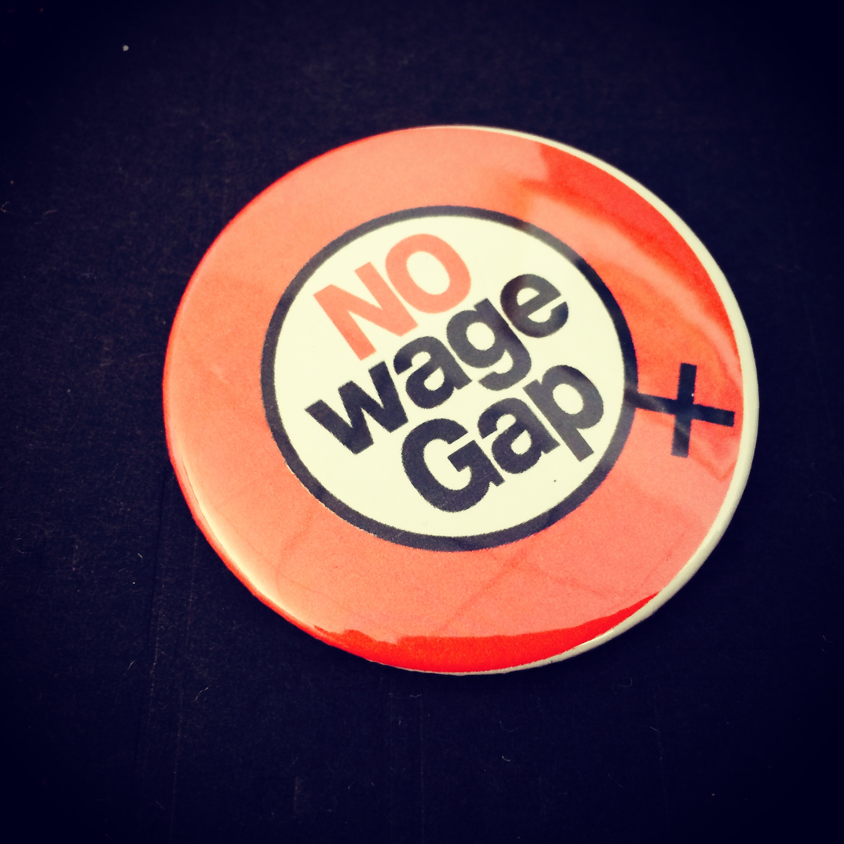
How to overcome these challenges?
Notes:
Launch with the same strategy to release the existing unrest and give the audience a ray of hope
Sell on our values of carbon free world which will give the audience something to stand for and our brand will have a story of its own
Consider wage issues in Bangladesh and provide attractive wage packages to the labor so as not to fall victim of the current scandal

Slide 18
Integrated Marketing Communications
Notes:
Our employees will be coherent when it comes to talking about our brand ideology so that one message goes in and out of the organization
Work on external communication so there is no discrepancy about our values as a brand
We want our consumers to understand us better and build that connect with us so that we become more than just a tee-shirt company for them

Slide 19
Taking their doubts as our own
Exploitation
Low wages
Existing competition
Local players
Notes:
One of their biggest concerns would be Zeal exploiting their current wage gap and paying their workers bare minimum wages just like every other company
We will give the wages slightly higher than their existing rate so to build the trust among the locals
We will communicate our plans clearly and have press conferences as part of our public relations campaign

Slide 20
Cont.
Natural dislike
Start ups
Healthy competition
Franchising
Notes:
Young youth is also into setting up their own start-ups which include a number of clothing brands as well
Moreover, Zeal might be a threat to existing local companies in Bangladesh and hence, we might generate some sentiments of natural dislike
However, we will communicate that we are up for healthy competition and we are also looking for opportunities through which we can bring some franchising partners on board as well when we will move towards retail side

Slide 21
Wrapping it up
Zeal.Co
Notes:
It’s high time for Zeal to spread its wings and expand in other markets
Bangladesh with all the provided statistics seems to be a lucrative market with lesser production costs and higher sales opportunities
Bangladesh is perfect in terms of Asian market as it’s not as large as India but still cosmopolitan enough
And from there on we can expand to other countries and make it even a bigger brand

